Slide 1
SECURE DATA HIDING IN IMAGES USING STEGANOGRAPHY
CAPSTONE PROJECT
Presented By:SAVULA SNEHITHA
Student Name : SAVULA SNEHITHA
College Name & Department : MALLA REDDY COLLEGE OF ENGEREENING AND TECHNOLOGY-EMERGING TECHNOLOGY(DATA SCIENCE)

Slide 2
OUTLINE
Problem Statement
Technology used
Wow factor
End users
Result
Conclusion
Git-hub Link
Future scope

Slide 3
Problem Statement
It revolves around embedding sensitive or confidential information within digital images in a way that the data remains invisible to the human eye.
while ensuring it is secure from unauthorized access or detection.
The primary challenge is to develop methods that can efficiently hide data without affecting the image's visual quality.
It create robust techniques that protect the data from attacks like image compression or distortion.
Ensuring secure communication and privacy in digital media.

Slide 4
Technology used
PROGRAMMING LANGUAGE:
PYTHON:Used for building encryption and decrtption data.
Libraries and framework
openCV-handles image processing and manipulation.
Numpy-supports array basedoperations for embedding messages.
PyQt6-creates a user friendly GUI for encryption and decryption.
Platforms:
-runs on windows,Linux and macOS python python installed.

Slide 5
Wow factors
1. Invisible Data Transmission:
-Invisibility: The ability to hide data in plain sight within an image, without altering its visual appearance, is incredible.
2. Enhanced Security:
- Encryption and Obfuscation: By combining encryption and steganography, the hidden data is not only invisible.
3. Real-World Applications:
- Digital Forensics and Secret Communication: Steganography can be used to send secret messages.
- Watermarking for Copyright Protection: Artists and content creators can use steganography to hide copyright information.
4. Resilience Against Attacks:
- Robustness: Advanced steganography methods can make the hidden data resistant to various types of attacks like image compressiion.
5. Future of Privacy Protection:
- Next-Gen Privacy: As data privacy becomes increasingly important, steganography offers an innovative approach to secure and stealthy communication in the digital age.

Slide 6
End users
1.Government and Military Organizations:
- For secure communication of sensitive data, especially in scenarios where traditional encryption methods might attract attention.
2. Cybersecurity Experts:
- Steganography can be used by cybersecurity professionals to test the resilience of their security systems or to covertly transfer threat intelligence between systems without detection.
3. Journalists and Activists:
- Hiding messages or files within images can be a means for journalists and human rights activists to safely share information in repressive environments.
4. Digital Content Creators:
- Content creators, such as artists or photographers, might use steganography to watermark their work with copyright information or to hide extra content within images as a part of digital storytelling.
5. Healthcare Providers:
- Use Case: Hospitals or medical professionals might use steganography to securely transmit patient data or sensitive medical records embedded within images.
6. Social Media User:
- Use Case: Individuals might use steganography to share private messages or hidden content
7. Digital Forensics Experts:
- Use Case: Forensic professionals can utilize steganography to hide data in digital evidence or images while investigating cybercrimes or to track information over time.

Slide 7
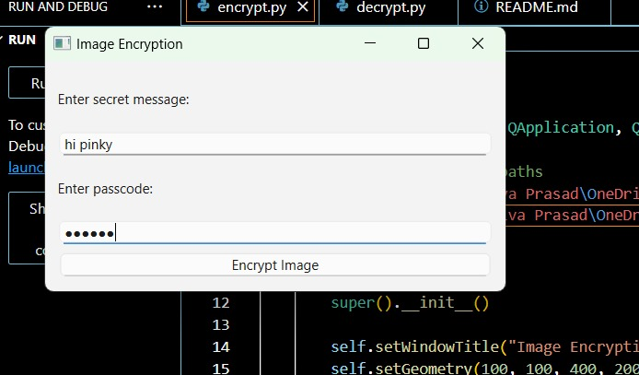
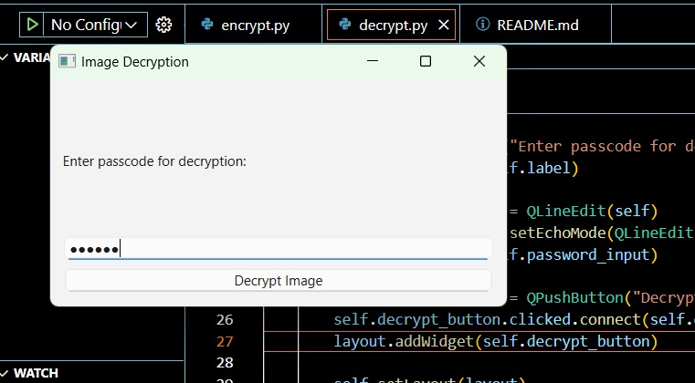
Results

Slide 8
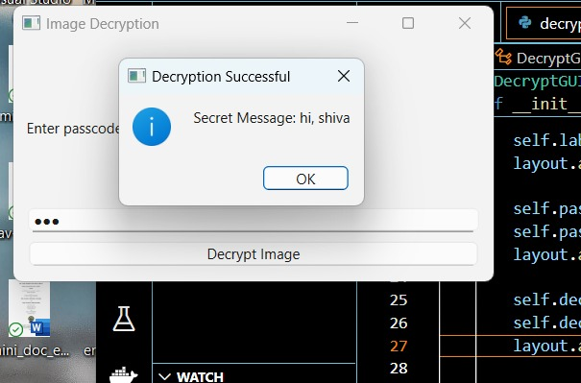
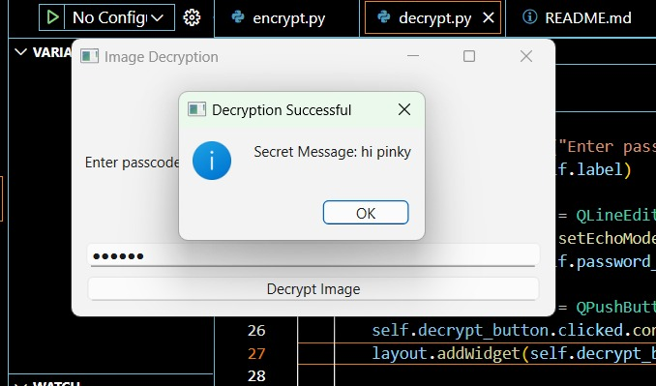

Slide 9
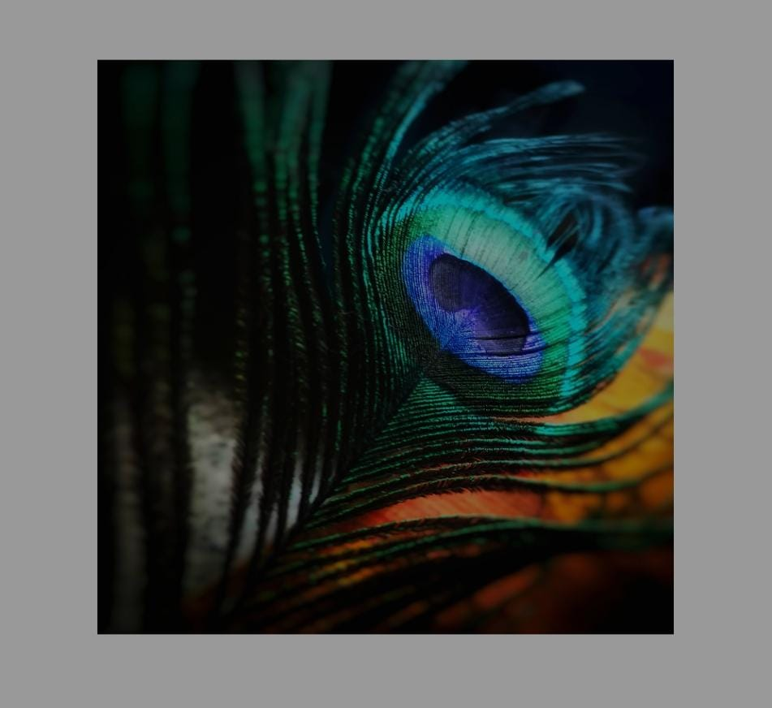
figue:encrypted image

Slide 10
Conclusion
It offers a powerful and innovative approach to enhancing data security and privacy in an increasingly interconnected world.
By embedding sensitive information within digital images, steganography provides a covert, resilient, and efficient method of data protection, making it almost invisible to unauthorized parties.
Its applications extend across a wide range of fields—from government agencies and businesses to digital creators and privacy-conscious individuals—demonstrating its versatility and importance in securing communication channels and protecting intellectual property.
As technology evolves, the integration of advanced encryption and machine learning techniques could further enhance the effectiveness and robustness of steganography.
ensuring it remains a vital tool in safeguarding sensitive information. Ultimately, steganography not only secures data but also enables the future of secure, private digital communication in both everyday and high-stakes environments.

Slide 11
GitHub Link
https://github.com/snehi16savula/Steganography---Hiding-Text-Under-Image#cloning-the-repository

Slide 12
Future scope(optional)
1. Integration with Artificial Intelligence (AI) and Machine Learning:
- Smart Detection and Encoding: AI algorithms can be used to detect patterns in images for more efficient encoding and decoding of hidden data.
- Automated Data Hiding: AI can analyze an image's structure and choose the best locations for embedding hidden information.
2. Enhanced Security with Quantum Cryptography:
- Post-Quantum Security: With the rise of quantum computing, traditional encryption methods may become vulnerable.
- Quantum-Resistant Algorithms: As quantum computers become more powerful, developing steganographic.
3. Robustness Against Advanced Detection Techniques:
- Improved Anti-Detection Techniques: As automated tools become better at detecting steganography.
- Adversarial Machine Learning: Leveraging adversarial machine learning models to make hidden data.
4. Real-Time Data Hiding and Retrieval:
- Streaming and Video Applications: The future of steganography may extend to real-time data hiding in video streams.
5. Cross-Platform and Multimodal Steganography:
- Beyond Images: Steganography could expand into other media types, such as audio, video, and 3D models, creating opportunities for multimodal data hiding. This could include hiding information in music files, video frames, or even augmented and virtual reality environments.
- Cross-Platform Data Hiding: With the increasing use of cloud services and cross-platform applications.

Slide 13
THANK YOU

